Slide 1
Chapter 5
Domain Name System (DNS)
Copyright © 2010, Elsevier Inc. All rights Reserved
Notes:
The University of Adelaide, School of Computer Science
Chapter 2 — Instructions: Language of the Computer

Slide 2
Infrastructure Services
There are some protocols that are essential to the smooth running of the Internet, but that don’t fit neatly into the strictly layered model.
Domain Name System (DNS)
– translate host names into host addresses
  a distributed database implemented in a hierarchy of name servers
  an application level protocol for message exchange between clients an
  Supports host aliasing
DNS allows the users of other applications to refer to remote hosts by name rather than by address.
Notes:
The University of Adelaide, School of Computer Science
Chapter 2 — Instructions: Language of the Computer

Slide 3
DNS
  While perfectly suited for processing by routers, addresses are not exactly user-friendly.
  It is for this reason that a unique name is also typically assigned to each host in a network.
  Host names differ from host addresses in two important ways.
    First, they are usually of variable length and mnemonic, thereby making them easier for humans to remember.
    Second, names typically contain no information that helps the network locate (route packets toward) the host.
Notes:
The University of Adelaide, School of Computer Science
Chapter 2 — Instructions: Language of the Computer

Slide 4
DNS
    Name Space - A name space can be either flat (names are not divisible into components), or it can be hierarchical (Unix file names are an obvious example).
    Bindings -the naming system maintains a collection of bindings of names to values
    Resolution mechanism - procedure that, when invoked with a name, returns the corresponding value. A name server is a specific implementation of a resolution mechanism that is available on a network and that can be queried by sending it a message.
Notes:
The University of Adelaide, School of Computer Science
Chapter 2 — Instructions: Language of the Computer

Slide 5
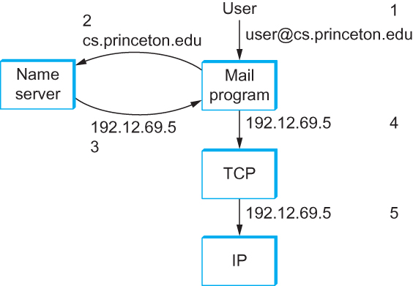
DNS
Early period – Network Information Center(NIC) – central authority
Notes:
The University of Adelaide, School of Computer Science
Chapter 2 — Instructions: Language of the Computer

Slide 6
DNS
Domain Hierarchy
  DNS implements a hierarchical name space for Internet objects. Unlike Unix file names, which are processed from left to right with the naming components separated with slashes, DNS names are processed from right to left and use periods as the separator.
  Like the Unix file hierarchy, the DNS hierarchy can be visualized as a tree, where each node in the tree corresponds to a domain, and the leaves in the tree correspond to the hosts being named.
Notes:
The University of Adelaide, School of Computer Science
Chapter 2 — Instructions: Language of the Computer

Slide 7
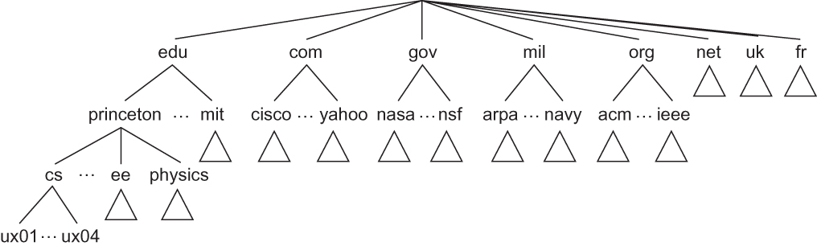
Domain Hierarchy
Example of a domain hierarchy
Notes:
The University of Adelaide, School of Computer Science
Chapter 2 — Instructions: Language of the Computer

Slide 8
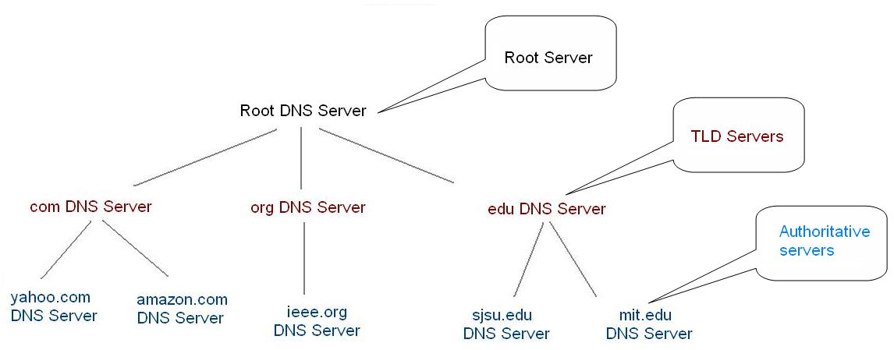

Slide 9
Name Servers
  The first step is to partition the hierarchy into subtrees called zones.
  Each zone can be thought of as corresponding to some administrative authority that is responsible for that portion of the hierarchy.
  For example, the top level of the hierarchy forms a zone that is managed by the Internet Corporation for Assigned Names and Numbers (ICANN).
Notes:
The University of Adelaide, School of Computer Science
Chapter 2 — Instructions: Language of the Computer

Slide 10
Name Servers
  Each name server implements the zone information as a collection of resource records.
  In essence, a resource record is a name-to-value binding, or more specifically a 5-tuple that contains the following fields:
  <Name, Value, Type, Class, TTL >
Notes:
The University of Adelaide, School of Computer Science
Chapter 2 — Instructions: Language of the Computer

Slide 11
Name Servers
  The Name and Value fields are exactly what you would expect, while the Type field specifies how the Value should be interpreted.
    Type = A indicates that the Value is an IP address. Thus, A records implement the name-to-address mapping we have been assuming. Other record types include
    NS: The Value field gives the domain name for a host that is running a name server that knows how to resolve names within the specified domain.
    CNAME: The Value field gives the canonical name for a particular host; it is used to define aliases.
    MX: The Value field gives the domain name for a host that is running a mail server that accepts messages for the specified domain.
Notes:
The University of Adelaide, School of Computer Science
Chapter 2 — Instructions: Language of the Computer

Slide 12
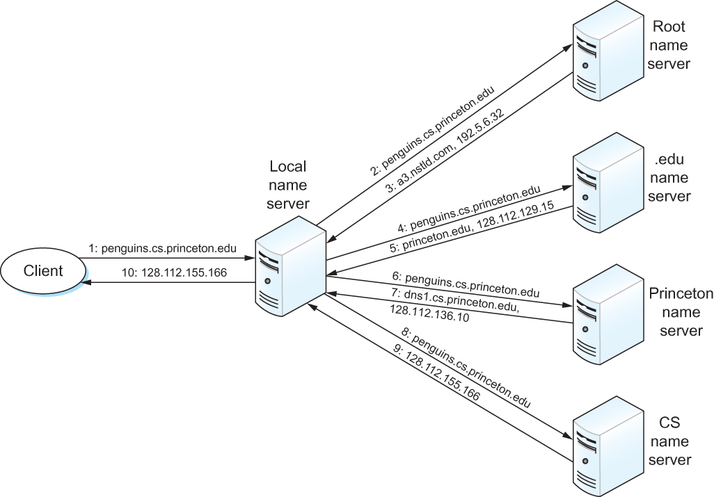
Notes:
The University of Adelaide, School of Computer Science
Chapter 2 — Instructions: Language of the Computer

Slide 13
<edu,a3.nstld.com,NS,IN>
<a3.nstld.com,192.5.6.32,A,IN>
<com,a.gtld-servers.net,NS,IN>
< a.gtld-servers.net, 192.5.6.30,A,In>
<princeton.edu,dns.princeton.edu,NS,IN>
<dns.princeton.edu,128.112.129.15,A,INivers.net, 192.5.6.30,A,IN>

Slide 14
THANK YOU
Notes:
The University of Adelaide, School of Computer Science
Chapter 2 — Instructions: Language of the Computer

